Slide 1


Slide 2
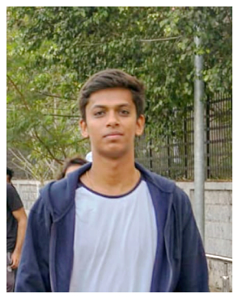
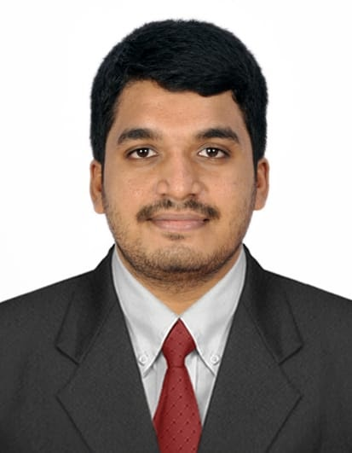
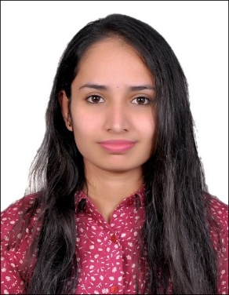
Project Highlights
Project Name :Rocket Webpage
Team Size : 03
BU Mentor Name : Mentor PS#
Team Members Details (Professional Stamp Size Photo with few lines of individual briefing
Intern Name – Arvind Kumar D R
PS#99002493
GENESIS Track Code - 2009BLRICP01
Education Details - BE- CSE
Professional Skills - Team Player
Intern Name – R Pavan Raj
PS#99002460
GENESIS Track Code - 2009BLRICP01
Education Details - BE- ECE
Professional Skills - Team Player
Intern Name – Bindu K R
PS# 99002454
GENESIS Track Code – 2009BLRICP01
Education Details – B.E, EE
Professional Skills – Teamplayer

Slide 3
Project Video Snippet

Slide 4
Future development that can be implemented further
This project currently is of have static type which can be converter into dynamic page.
More games can be added to game page.
Live streaming can be added for the video streaming.
Design part can be enhanced.
More information can be provided in the webpage.

Slide 5

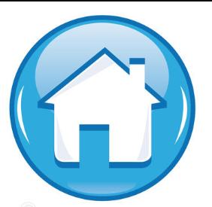
Thank You !

